Slide 1
BREAD: BUNS
Barcode Utilization for Navigating Stock
Nic Cywinski(CpE) - Senior
Nick Sandahl(CpE) - Junior
Adam Sandahl(CpE) - Junior

Slide 2
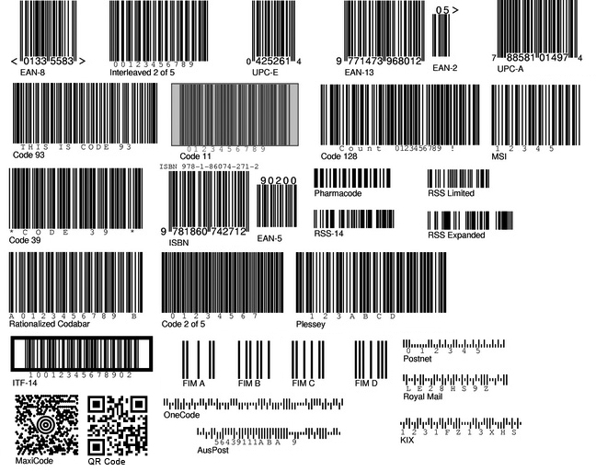
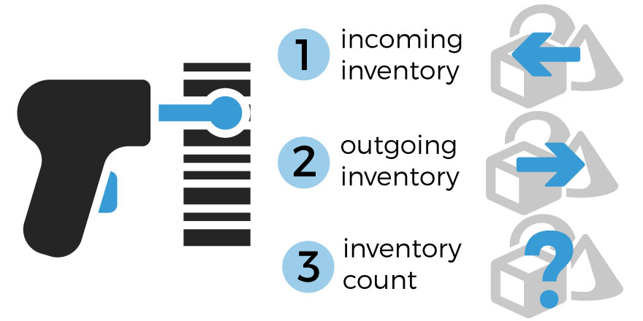
Project Overview
Inventory Management System
Production Rate
Product Description
Product Quantities
Product Locations
Easily Expandable
Broadly Applicable
Searchable Product Database

Slide 3
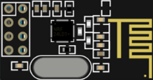
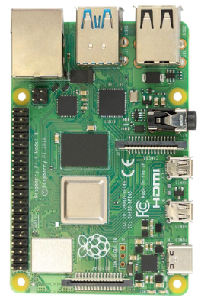
Hardware Data Path
Scanner
Slice
Loaf

Slide 4
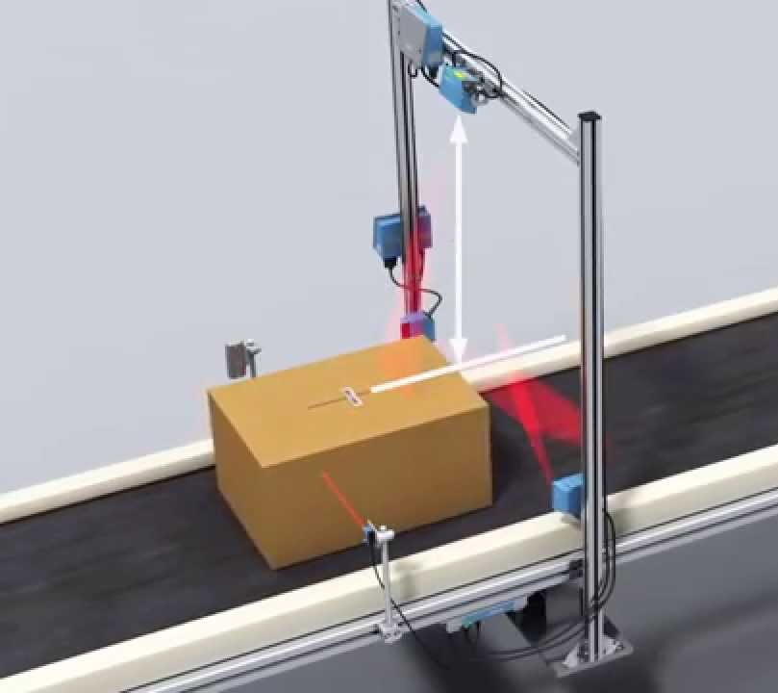
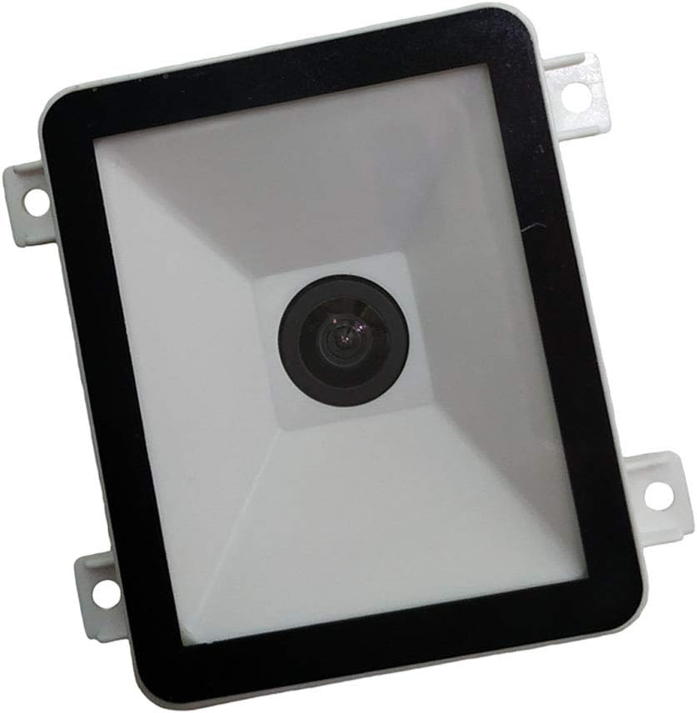
Current Scanner
Maikrt Embedded Scanning Module UART connection
Fixed Barcode Scanner
Automatic Object Detection
<1 sec refresh rate

Slide 5
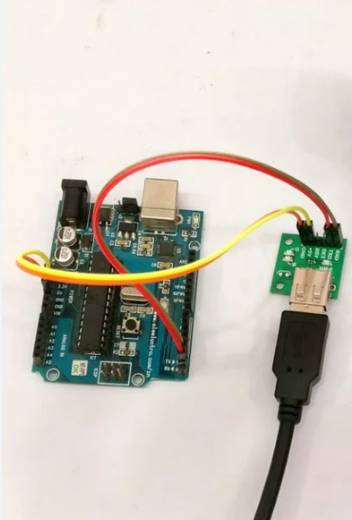
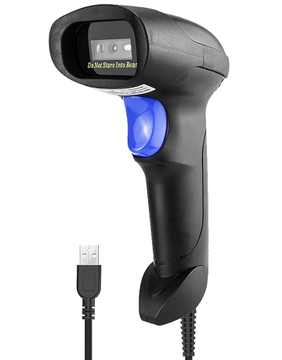
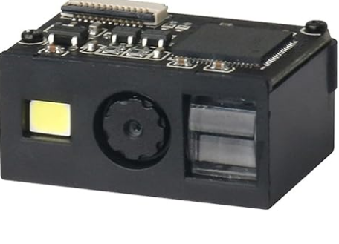
Portable Scanner
USB:
Pre-built Scanner
Cheap
Interchangeable
TTL
Custom:
Design custom housing
Internal arduino and battery
TTL

Slide 6
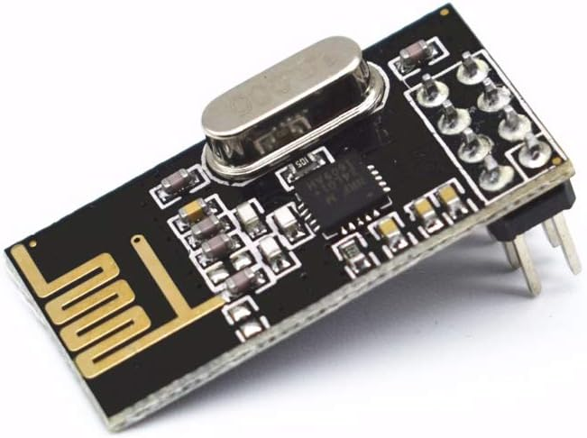
Slice
Raspberry Pi 4 Model B
Hosts Web Server
Arduino
Receiver for all Scanner modules
NRF24L01+ Wireless Transceiver Module 2.4GHz
Loaf-Slice Communication
Arduino and Pi connected Via Serial Communication
Slice Could Communicate Variety of Information to Loaf:
Rate of Scanning
Specific Item Quantities
Quantity of Items in Stock

Slide 7
Database and GUI
New product scanned
Barcode Data
Product
Description
Quantities
Locations
User edits product characteristics
Item uploaded to database
User can access list through GUI
Database tracks newly added barcodes.

Slide 8
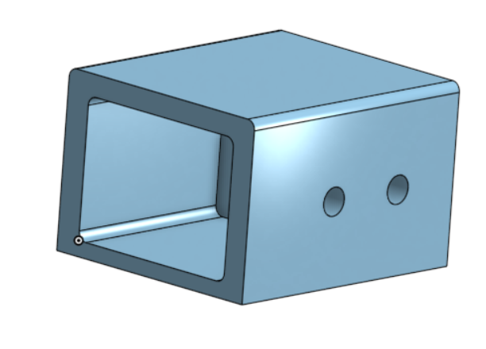
Next Steps
Radio Communication
Continue work on back and forth Communication
Scanner housing designed.
3d printed housing
Easily mountable
Circuit Board Designs
Layout the components and traces
One for Slice and one for Scanner
Database Design
Easily expandable
Reconfigurable
Arduino-Pi Communication
Scanner uploading values to database.
Build User Interface

Slide 9
Questions?

Slide 10
Thank You

